Slide 1
Database Systems
Lecture 1
THE RELATIONAL DATA MODEL AND RELATIONAL DATABASE CONSTRAINTS
Chapter 5
Alina Arshad
alina.arshad@nu.edu.pk

Slide 2
DBMS Formal terms
Informal Terms | Formal terms
Table Name | Entities
Table | Relation
Column Name | Attributes
Row | Tuple
Values in a column | Domain
Table definition | Schema of a relation
Populated Table | Extension

Slide 3
Relational Model Concepts
Relational model: represents the database as a collection of relations.
Relation: Table of values
Tuple represent facts: Row
Column Header: Attribute
Domain: Data type describing the types of values that can appear in each column.
The model was first proposed by Dr. E.F. Codd of IBM Research in 1970 in the following paper:“ A Relational Model for Large Shared Data Banks," Communications of the ACM, June 1970

Slide 4
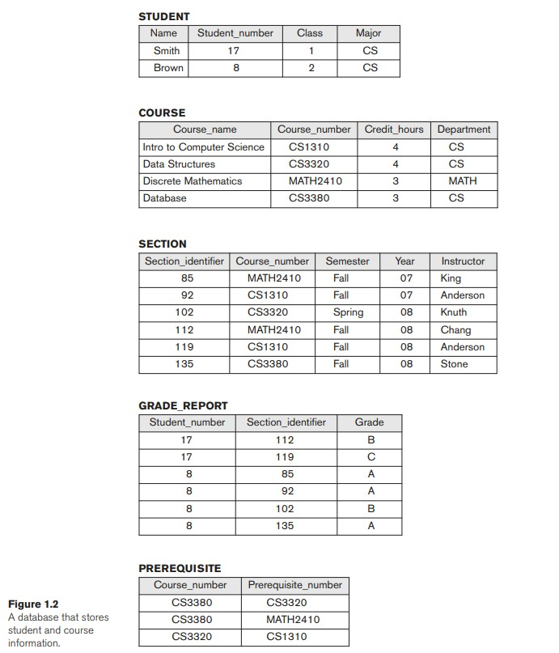

Slide 5
Relational Model Concepts
Domain: Set of atomic values
Represents data type, and format.
For example, the PAK_phone_numbers may have a format: (ddd)-dddddddd where each d is a decimal digit.
Dates have various formats such as month, date, year or yyyy-mm-dd, or dd mm,yyyy etc.
Names: set of character strings that represent names of persons.
Grade_point_averages: floating-point number between 0 and 4.
Employee_ages: integer value between 15 and 80.

Slide 6
Formal Definition of Relation
A relation schema.
denoted by R(A1, A2, … , An),
made up of a relation name R
Contains a list of attributes, A1, A2, … , An.
Each attribute Ai is the name of a role played by some domain D in the relation schema R. D is called the domain of Ai and is denoted by dom(Ai).
Degree (or arity) of a relation:
number of attributes/columns
Tuple t is a row:
Ordered/ unordered list of n values t =<v1,v2…vn>
each value vi, 1 ≤ i ≤ n, is an element of dom (Ai) or is a special NULL value.

Slide 7
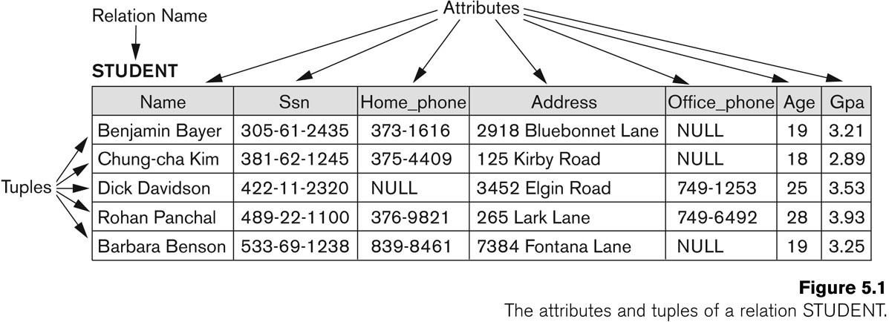
Example of a Relation
Degree of Relation?

Slide 8
Relation Definition Using set theory
Relation A (Customer):
Customer ID, Name
(1, John)
(2, Jane)
Relation B (Order):
Order ID, Customer ID
(101, 1)
(102, 2)
The Cartesian product of A and B would be:
Relation C (Customer_Order):
Customer ID, Name, Order ID
(1, John, 101)
(1, John, 102)
(2, Jane, 101)
(2, Jane, 102)
A relation (or relation state) r(R) is a mathematical relation of degree n on the domains dom(A1), dom(A2), … , dom(An), which is a subset of the Cartesian product (denoted by ×) of the domains that define
R: r(R) ⊆ (dom(A1) × dom(A2) × . . . × (dom(An))
Cartesian product: All possible combinations of values from the underlying domains.
Total number of tuples in the Cartesian product:
|dom(A1)| × |dom(A2)| × . . . × |dom(An)|

Slide 9
Relational Model Concepts
Relation State: The state of the whole database will correspond to the states of all its relations at a particular point in time.

Slide 10
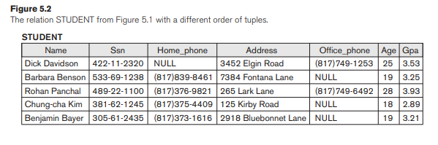
Characteristics of Relations
Relation: set of tuples.
Ordering of Tuples in a Relation: tuples in a relation do not have any particular order.
Hence, the relation displayed in Figure 5.2 is considered identical to the one shown in Figure 5.1

Slide 11
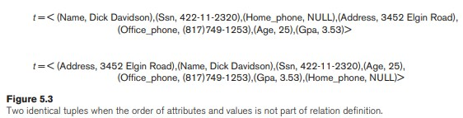
Characteristics of Relations
Ordering of Attributes is not important, because the attribute name appears with its value.
When the attribute name and value are included together in a tuple, it is known as self-describing data.

Slide 12
Characteristics of Relations
Values and NULLs in the Tuples:
Each value in a tuple is an atomic value.
composite and multivalued attributes are not allowed
NULL values: values of attributes that may be unknown or may not apply to a tuple.

Slide 13
Relational Model Constraints
Constraints: set of rules or restrictions. They are used to maintain the quality of data.
Constraints ensure that the data insertion, updating, and other processes have to be performed in such a way that data integrity is not affected.
Constraints are used to guard against accidental damage to the database.

Slide 14
Relational Model Constraints
Schema Based Constraints
Divided into three main categories.
Key constraints
Entity integrity constraints
Referential integrity constraints
Key Constraints: used to identify an entity within its entity set uniquely.
Primary Key
Candidate Key
Super Key
Foreign Key

Slide 15
Key Constraints
Primary key: uniquely identifies each record in a table. It must have unique values and cannot have null values.
FOREIGN KEY: Foreign keys are the columns of a table that points to the primary key of another table. They act as a cross-reference between tables.
Candidate Key: A super key with no redundant attribute is known as candidate key.
Super Key: A super key is a set of one of more columns (attributes) to uniquely identify rows in a table.

Slide 16
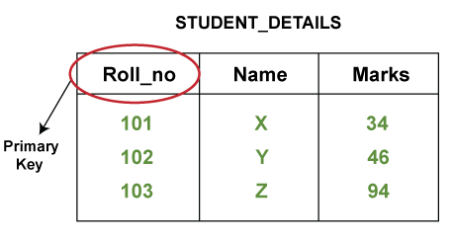
Primary Key Examples

Slide 17
Foreign Key Example
Course_enrollment table
Student table:
Course_Id | Stu_Id
C01 | 101
C02 | 102
C03 | 101
C05 | 102
C06 | 103
C07 | 102
Stu_Id | Stu_Name | Stu_Age
101 | Chaitanya | 22
102 | Arya | 26
103 | Bran | 25
104 | Jon | 21
Primary key
Foreign key

Slide 18
Candidate Example
Emp_Id | Emp_Number | Emp_Name
E01 | 2264 | Steve
E22 | 2278 | David
E23 | 2288 | Joseph
E45 | 2290 | Robert
The candidate keys we have
{Emp_Id}
{Emp_Number}

Slide 19
Super Key Example
Emp_Id | Emp_Number | Emp_Name
E01 | 2264 | Steve
E22 | 2278 | David
E23 | 2288 | Joseph
E45 | 2290 | Robert
How many super keys the above table can have?
{Emp_Id, Emp_Number}
{Emp_Id, Emp_Name}
{Emp_Id, Emp_Number, Emp_Name}
{Emp_Number, Emp_Name}

Slide 20
Any question????

